Slide 1

Large Language Model(LLM)
Transformer & BERT
Artificial Intelligence Project
SWE3032-41 Prof. Hogun Park TA Jiwon Jeong

Slide 2



Table of Contents
Part 1
- Language Model
Part 2
- Transformer
Part 3
- BERT
Part 4
- References

Slide 3

Part 1
Language Model

Slide 4

PART 1 Language Model
Introduction
Language Model is a model that represents the probability of a sentence
Predict the probability of occurrence of the sentence itself
A model to predict the next word given the previous words
버스 정류장에서 방금 버스를 OOO.
사랑해
고양이
굿바이
큰일남
놓쳤다

Slide 5

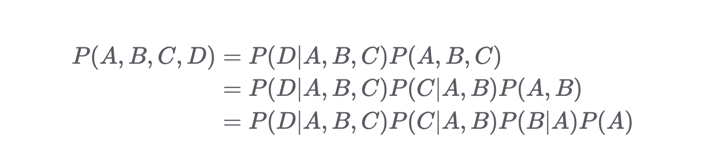
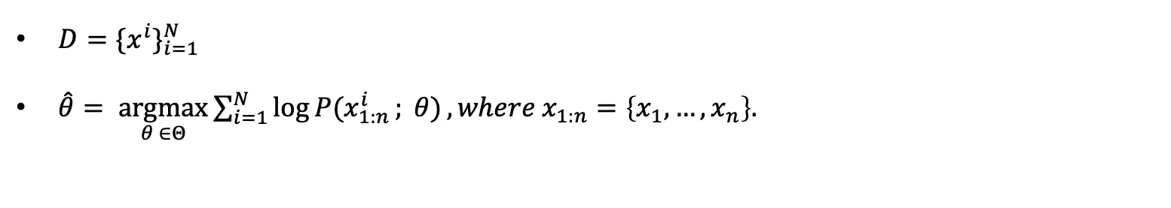
PART 1 Language Model
Objective :
$D=\{x^{i}\}_{i=1}^{N}$
$\hat{θ}= \underset{θ ∈Θ}{argmax}{\sum_{i=1}^{N}{log⁡P(x_{1:n}^{i}}; θ)}, where x_{1:n}=\left\{x_{1}, …,x_{n}\right\}.$
Chain Rule :
We can convert joint probability to conditional probability.

Slide 6
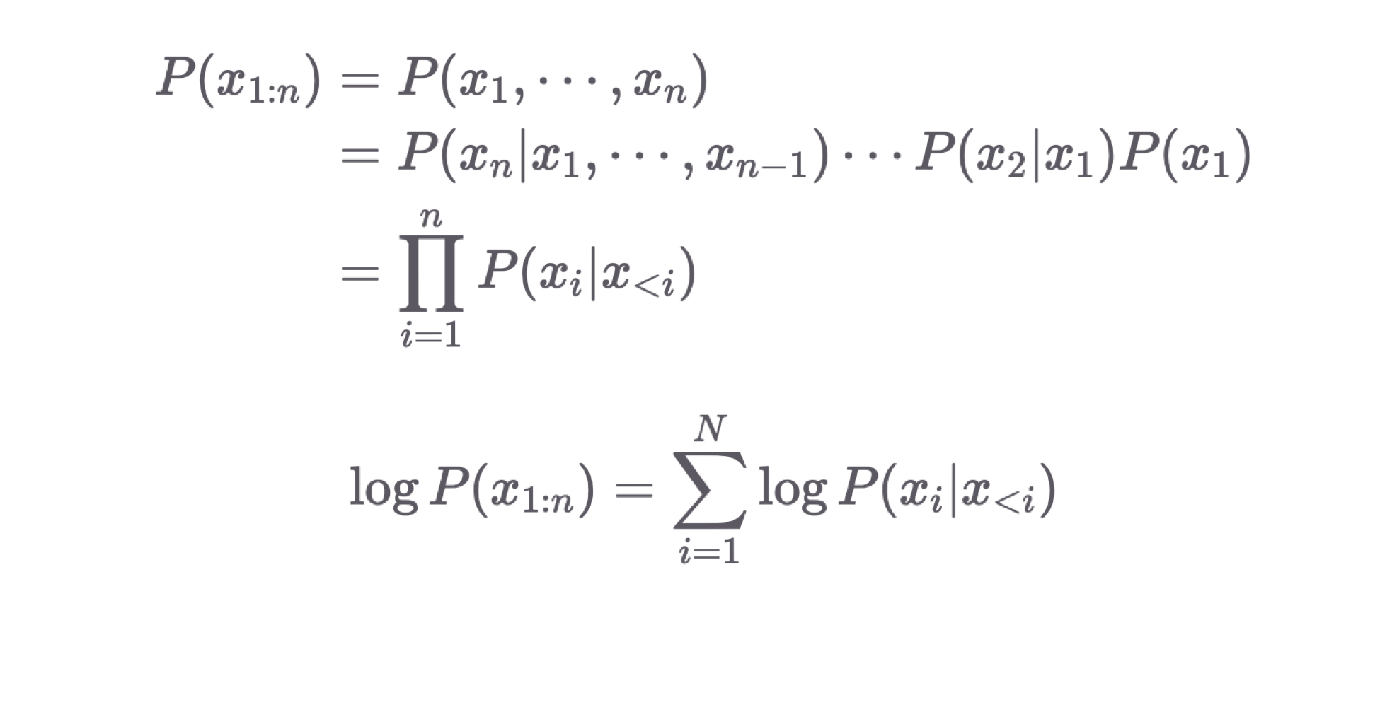
PART 1 Language Model
By Chain Rule,
We can re-write the equation,

Slide 7
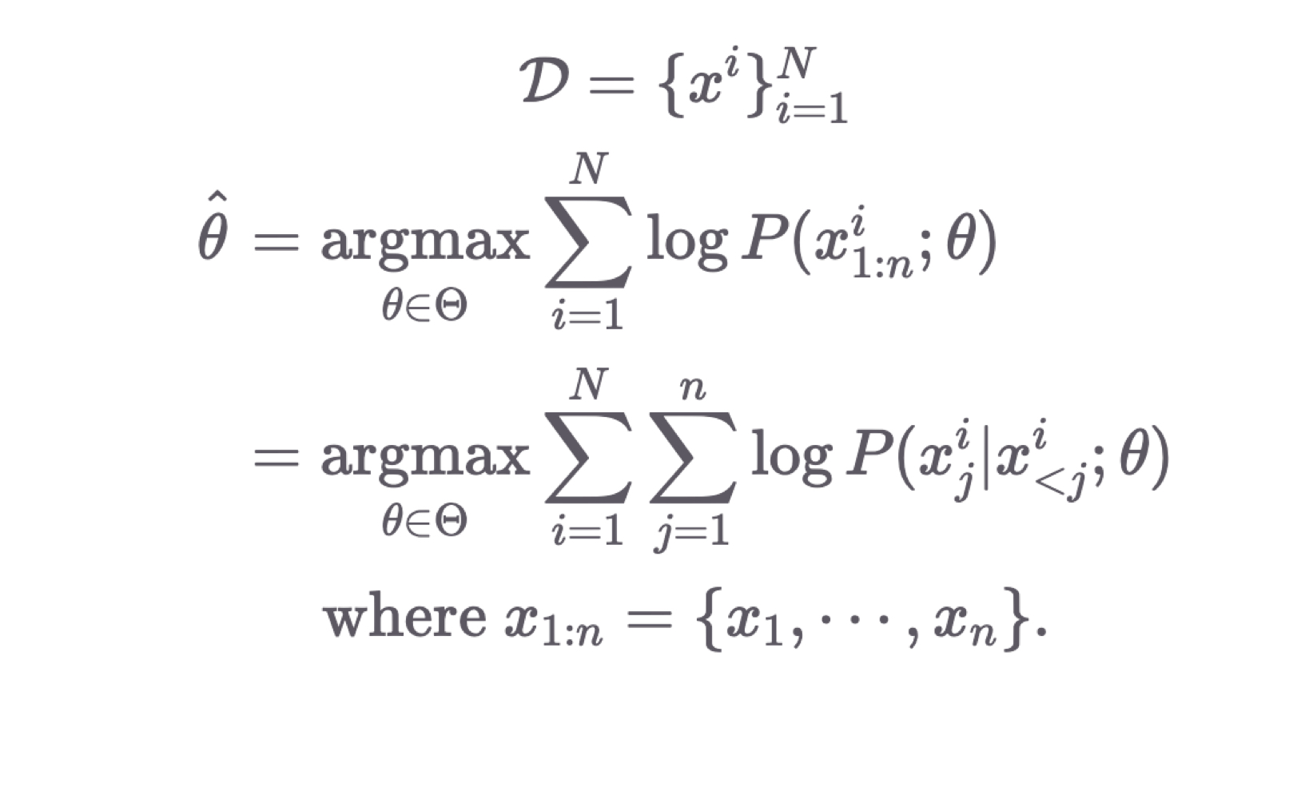
PART 1 Language Model
By Chain Rule,
We can re-write the Objective,

Slide 8
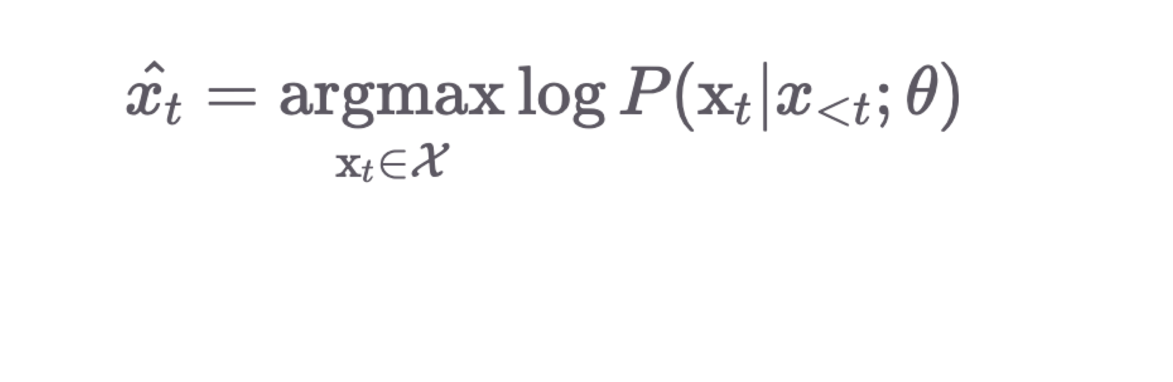
PART 1 Language Model
Using Language Model
Pick better(fluent) sentence
Predict next word given previous words.

Slide 9
Part 2
Transformer

Slide 10
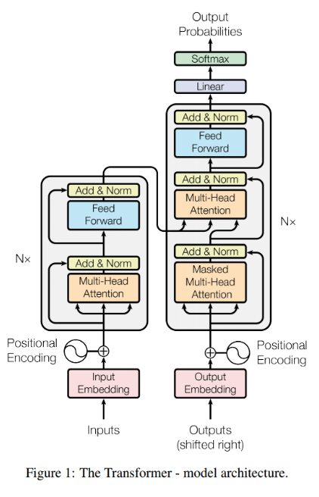
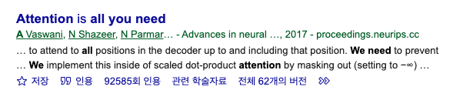
PART 2 Transformer
Attention is all you need

Slide 11

PART 2 Transformer
A High-Level Look
The encoding component is a stack of encoders
The decoding component is a stack of decoders of the same number

Slide 12
PART 2 Transformer
Self-Attention at a High Level
Input sentence to translate :
“The animal didn’t cross the street because it was too tired”
What does “it” in this sentence refer to? Street or animal?
Simple question to a human but not as simple to an algorithm
Self attention allows it to look at other positions in the input sequence for clues that can help lead to a better encoding for this word.
Self-attention is the method the Transformer uses to bake the “understanding” of other relevant words into the one we’re currently processing.

Slide 13

PART 2 Transformer
Self-Attention Example

Slide 14

PART 2 Transformer
Multi-Head Attention

Slide 15
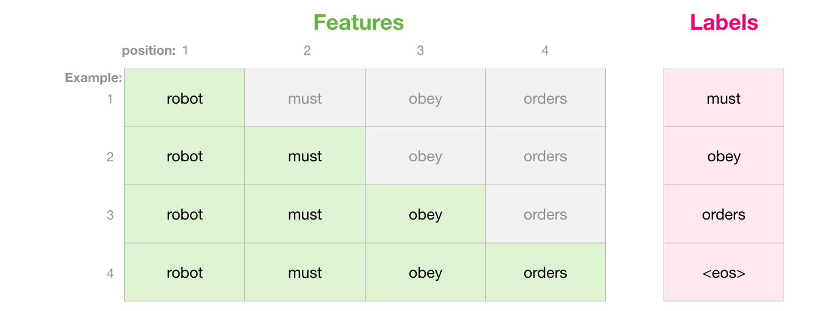
PART 2 Transformer
Masked Multi-Head Attention
Do not need to be done sequentially, but can be done at one batch

Slide 16
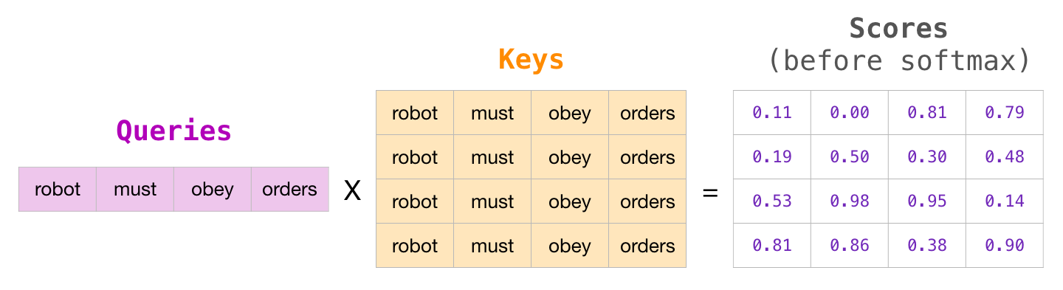
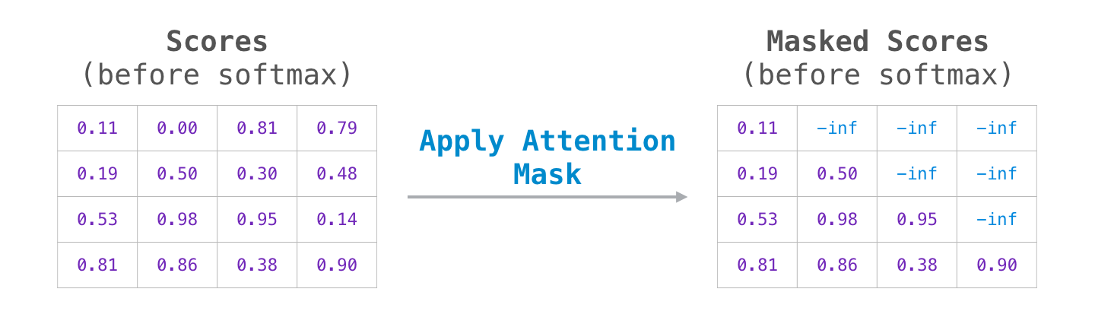
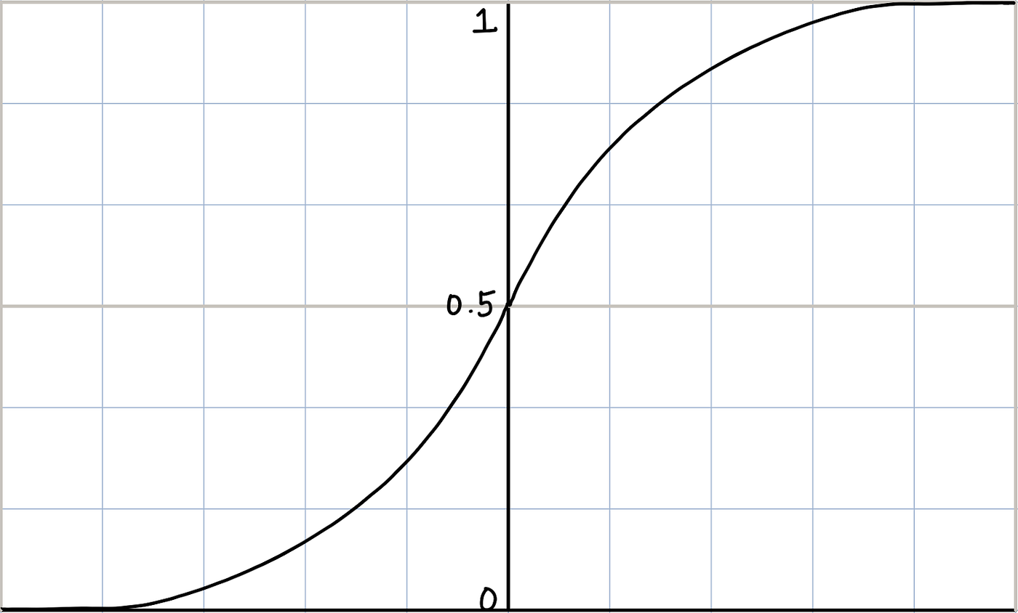
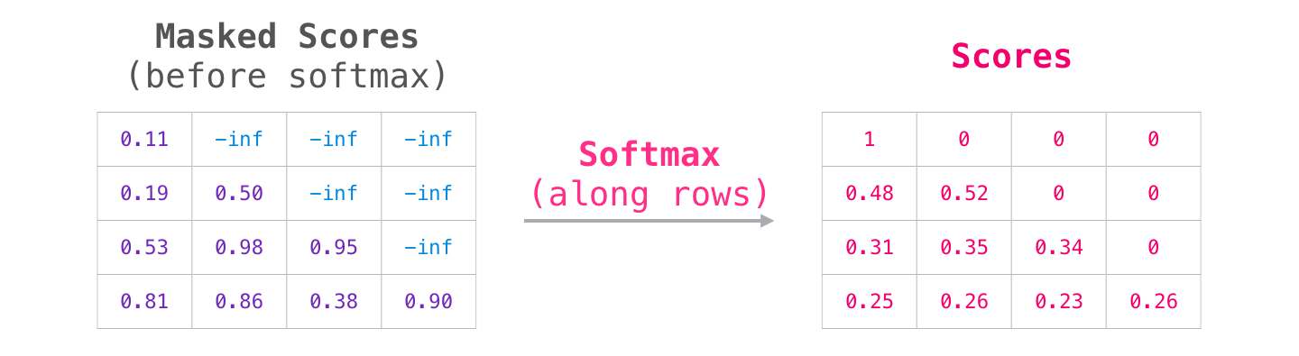
PART 2 Transformer
Masked Multi-Head Attention

Slide 17

PART 2 Transformer
The Decoder side

Slide 18

PART 2 Transformer
The Decoder side

Slide 19

Part 3
BERT

Slide 20
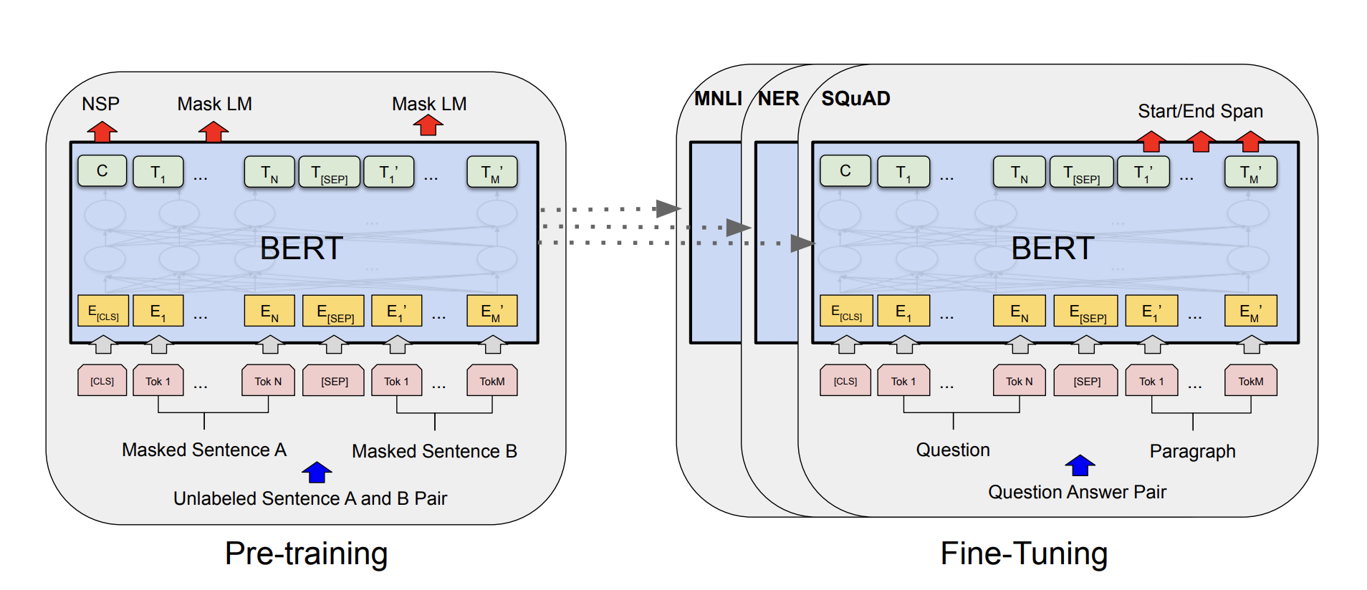
PART 3 BERT
BERT : Bidirectional Encoder Representations from Transformer
Designed to pretrain deep bidirectional representations from unlabeled text by jointly conditioning on both left and right context in all layers
Masked language Model(MLM) : bidirectional pre-training for language representations
Next sentence prediction(NSP)
Pretrained BERT model can be fine-tuned with just one additional output layer to create SOTA models for a wide range of NLP task(QA, NER, Sentiment Analysis, etc.)

Slide 21
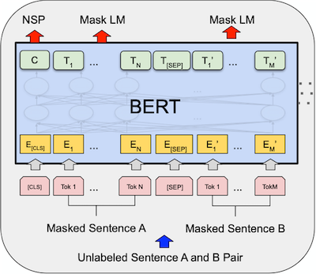
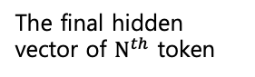
PART 3 BERT
BERT : Bidirectional Encoder Representations from Transformer
BERT : Input/Output Representations
The final hidden vector of $N^{th}$ token
The first hidden vector of special [CLS] token
The first token of every sequence
A special token which is differentiate the sentences

Slide 22
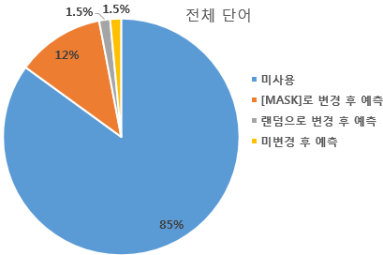
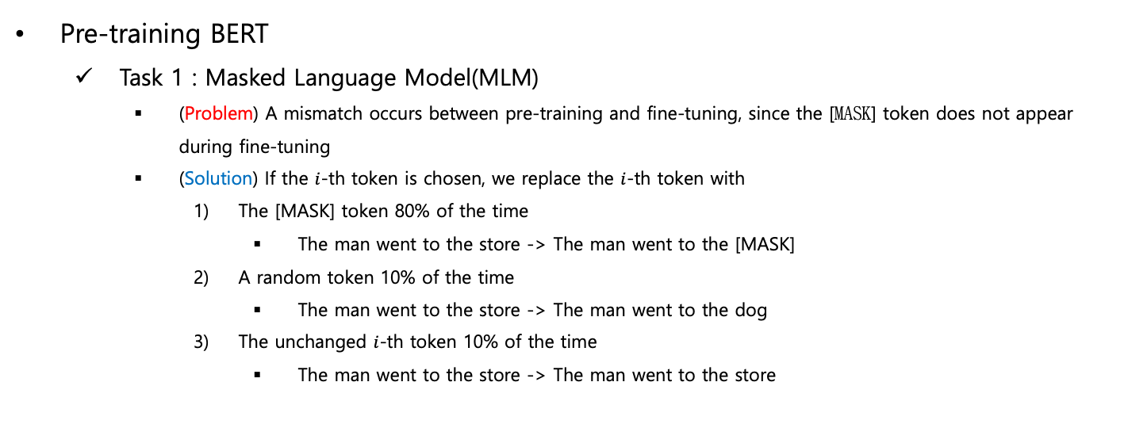
PART 3 BERT
BERT : Bidirectional Encoder Representations from Transformer
Pre-training BERT
Task 1 : Masked Language Model(MLM)
(Problem) A mismatch occurs between pre-training and fine-tuning, since the [MASK] token does not appear during fine-tuning
(Solution) If the $i$-th token is chosen, we replace the $i$-th token with
The [MASK] token 80% of the time
The man went to the store -> The man went to the [MASK]
A random token 10% of the time
The man went to the store -> The man went to the dog
The unchanged $i$-th token 10% of the time
The man went to the store -> The man went to the store

Slide 23
PART 3 BERT
BERT : Bidirectional Encoder Representations from Transformer
Pre-training BERT
Task 2 : Next Sentence Prediction(NSP)
Many important downstream task such as QA and NLI are based on understanding the relationship between two sentences, which is not directly captured by language modeling
A binarized next sentence prediction task that can be trivially generated from any monolingual corpus is trained
50% of the time B is the actual next sentence that follows A (IsNext)
50% of the time it is a random sentence from the corpus (NotNext)
C(CLS’s hidden vector) is used for next sentence prediction
Despite its simplicity, pre-training towards this task is very beneficial both QA and NLI

Slide 24
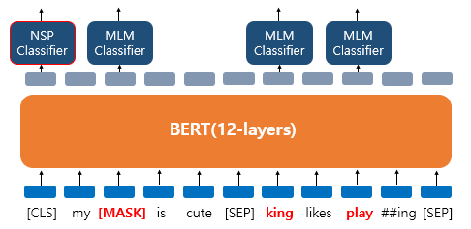
PART 3 BERT
BERT : Bidirectional Encoder Representations from Transformer
Pre-training BERT
Notes:
Dog -> MASK
He -> king
Play는 안변함

Slide 25
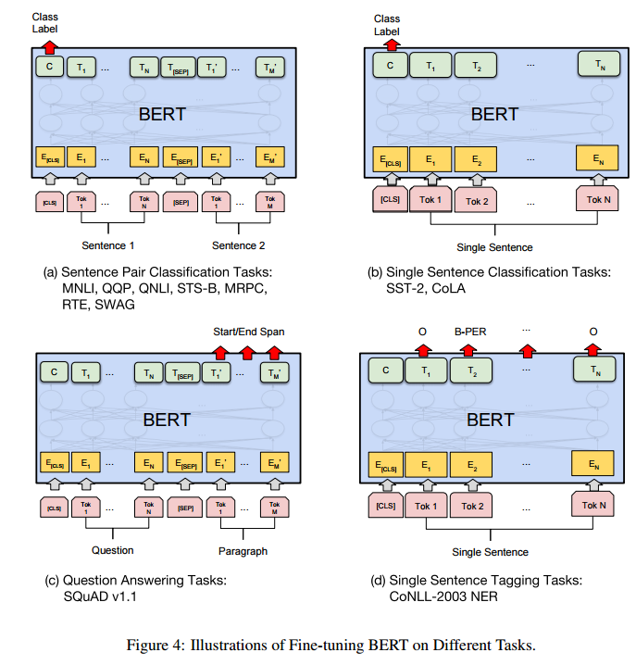
PART 3 BERT
BERT : Bidirectional Encoder Representations from Transformer
Fine-training BERT
Notes:
Dog -> MASK
He -> king
Play는 안변함

Slide 26
References
References
https://jalammar.github.io/illustrated-transformer/
https://jalammar.github.io/illustrated-gpt2/
https://towardsdatascience.com/bert-explained-state-of-the-art-language-model-for-nlp-f8b21a9b6270
https://wikidocs.net/115055

Slide 27

Thank you..!!!!
Thank you for listening.
Tell us if you have any questions
jwjw9603@g.skku.edu

